Slide 1
Partnership Led Skills Development
TransFormWork: Final Conference, Sofia, 20th February 2023

Slide 2
An agency
with a difference.
Driving Ireland’s competitiveness through talent.
A Government agency, we work in partnership with stakeholders, and businesses of all sizes, to identify and address their upskilling needs.
Our mission is to help businesses compete globally through industry-led people development.

Slide 3
Our
Approach
A partnership approach.
We collaborate directly with businesses in each industry sector, helping them define their skill needs. We respond with the frameworks and programmes to meet those needs, bringing together Government, industry and higher education to tailor the most effective response possible.

Slide 4
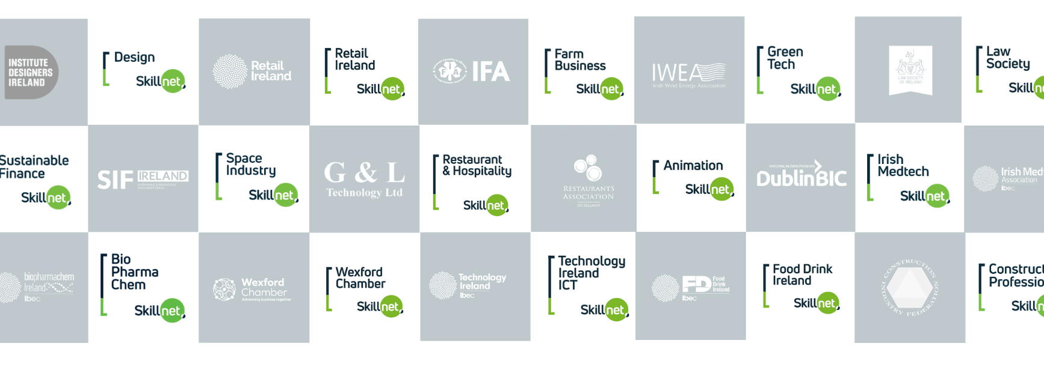
A Partnership with 73 Industry Bodies

Slide 5
Status and Reporting Structure
Skillnet Ireland Board (Company Limited by Guarantee & Public Body)
Chairperson
Brendan McGinty
Business and Employer Representatives (7)
(ICTU) Employee Representatives (3)
Ministerial Representatives (3)
Skillnet Ireland Organisation (40 Staff)
Strategy & Policy Alignment
Delivery Effectiveness
Funding & Operations
Finance, Governance & Risk
Communications & Marketing
Chief Executive
Paul Healy

Slide 6
Skillnet Ireland Areas of Focus
Digital
Skills
Skills for Climate Action & Sustainable Businesses
Management Skills & Mentoring for SME Sector
Skills
Supply to
FDI Sector
Future Skills, Research & Innovation

Slide 7
Skillnet Ireland Champions all learning that builds talent.
Leadership &
Management
Development
Specialised,
Sector Specific
Upskilling &
Employment
Pathways
Mentoring
& Coaching
Academic
Co-Creation &
Research
Continuing
Professional
Development
Networking
& Informal
Learning

Slide 8
Skillnet Ireland
Funding
Exchequer Funding from Ireland’s National Training Fund
Private Sector Co Investment on Programmes
EU Programme Funding
Source | 2023 Amount (€ Million)
National Training Fund | €44
Private Sector Co-Investment | €25
EU Programmes | €17
Total | €86M

Slide 9
How
Skillnet Ireland
Delivers
Collaboration: Gives a voice to employers and workers, brings together Government, industry, trade unions and the education/ training ecosystem.
Rapid & agile industry-led skills development.
Cost Sharing: Incentivises upskilling, drives quality and impact of programmes, and leverages public investment
Driving innovation and collaboration in skills development, new programmes for future skills and industry insights

Slide 10
Supporting the Implementation of
Government Strategies
Skillnet Ireland, together with our partners, contribute to both the formation and the implementation of enterprise and labour market policy and are delivering substantive actions across key cross Government and sectoral strategies.

Slide 11
Skillnet Ireland
2022 Outputs
Supported 21,500 businesses (85% SMEs)
Upskilled 82,000 workers
Supported 5,000 jobseekers into employment
Developed & funded 9,000 training courses
Delivered 100 innovation projects, Higher Education collaborations, research assignments and future skills programmes
Invested €78 million in Ireland’s Workforce

