Slide 1
Integrating AI in the Workpace
Prof. Alexiei Dingli

Slide 2
If it isn't
broke,
don’t
fix it

Slide 3
ONLINE
IS HERE
TO STAY

Slide 4
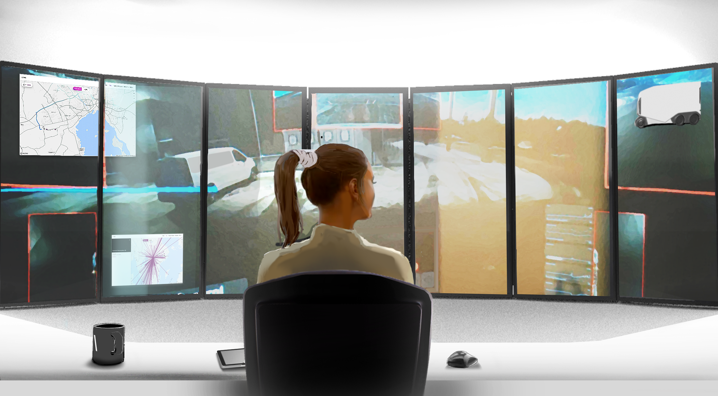
Notes:
The forklift truck drivers who never leave their desks
several screens
sensors
USA testing a robot pull over
police officer stays safe, most dangerous part of their job
checks car, identification, even inserts spikes under the car
Japan robot workers
café
people with ALS
move, observe, talk to customers, carry objects
eye movement of operators
New opportunities for disabled people
how many of them are at home
frustrated
can’t earn a living
give them dignity back with work
precious resources
we can use them productively

Slide 5
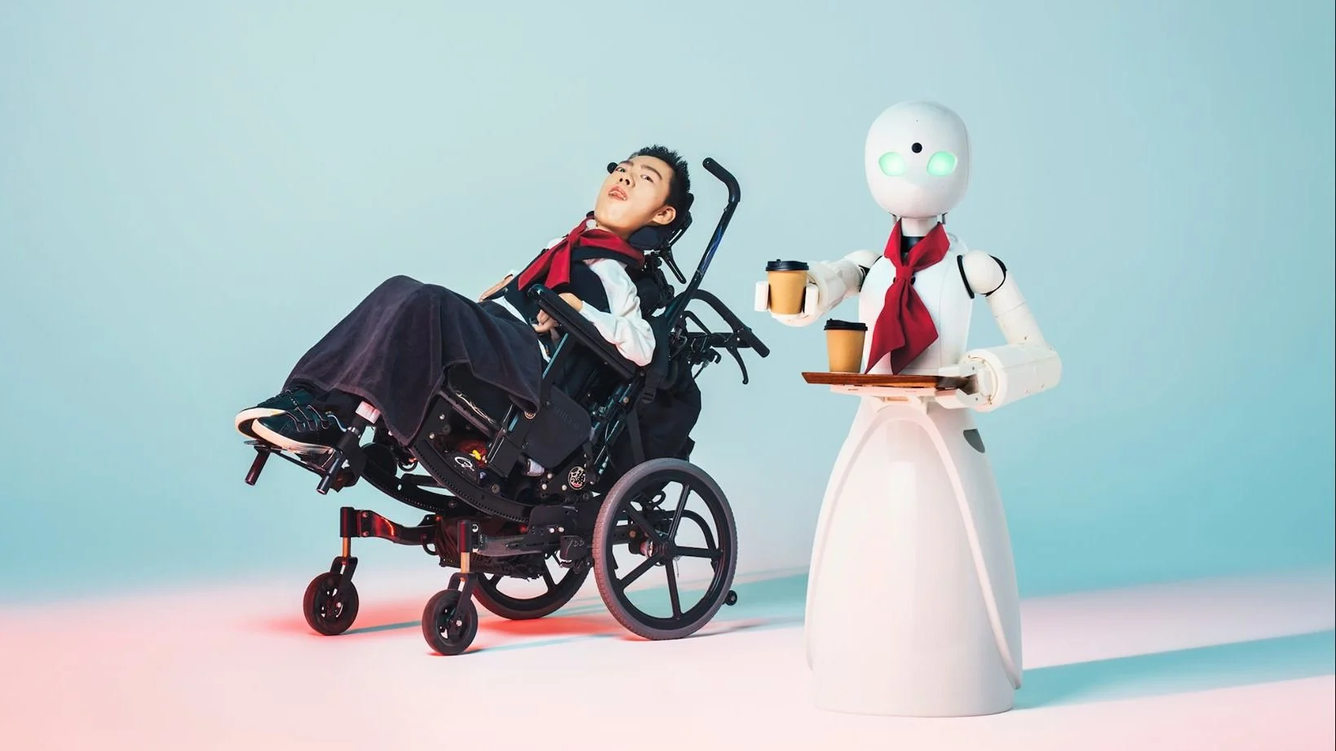
Use everyone’s potential

Slide 6
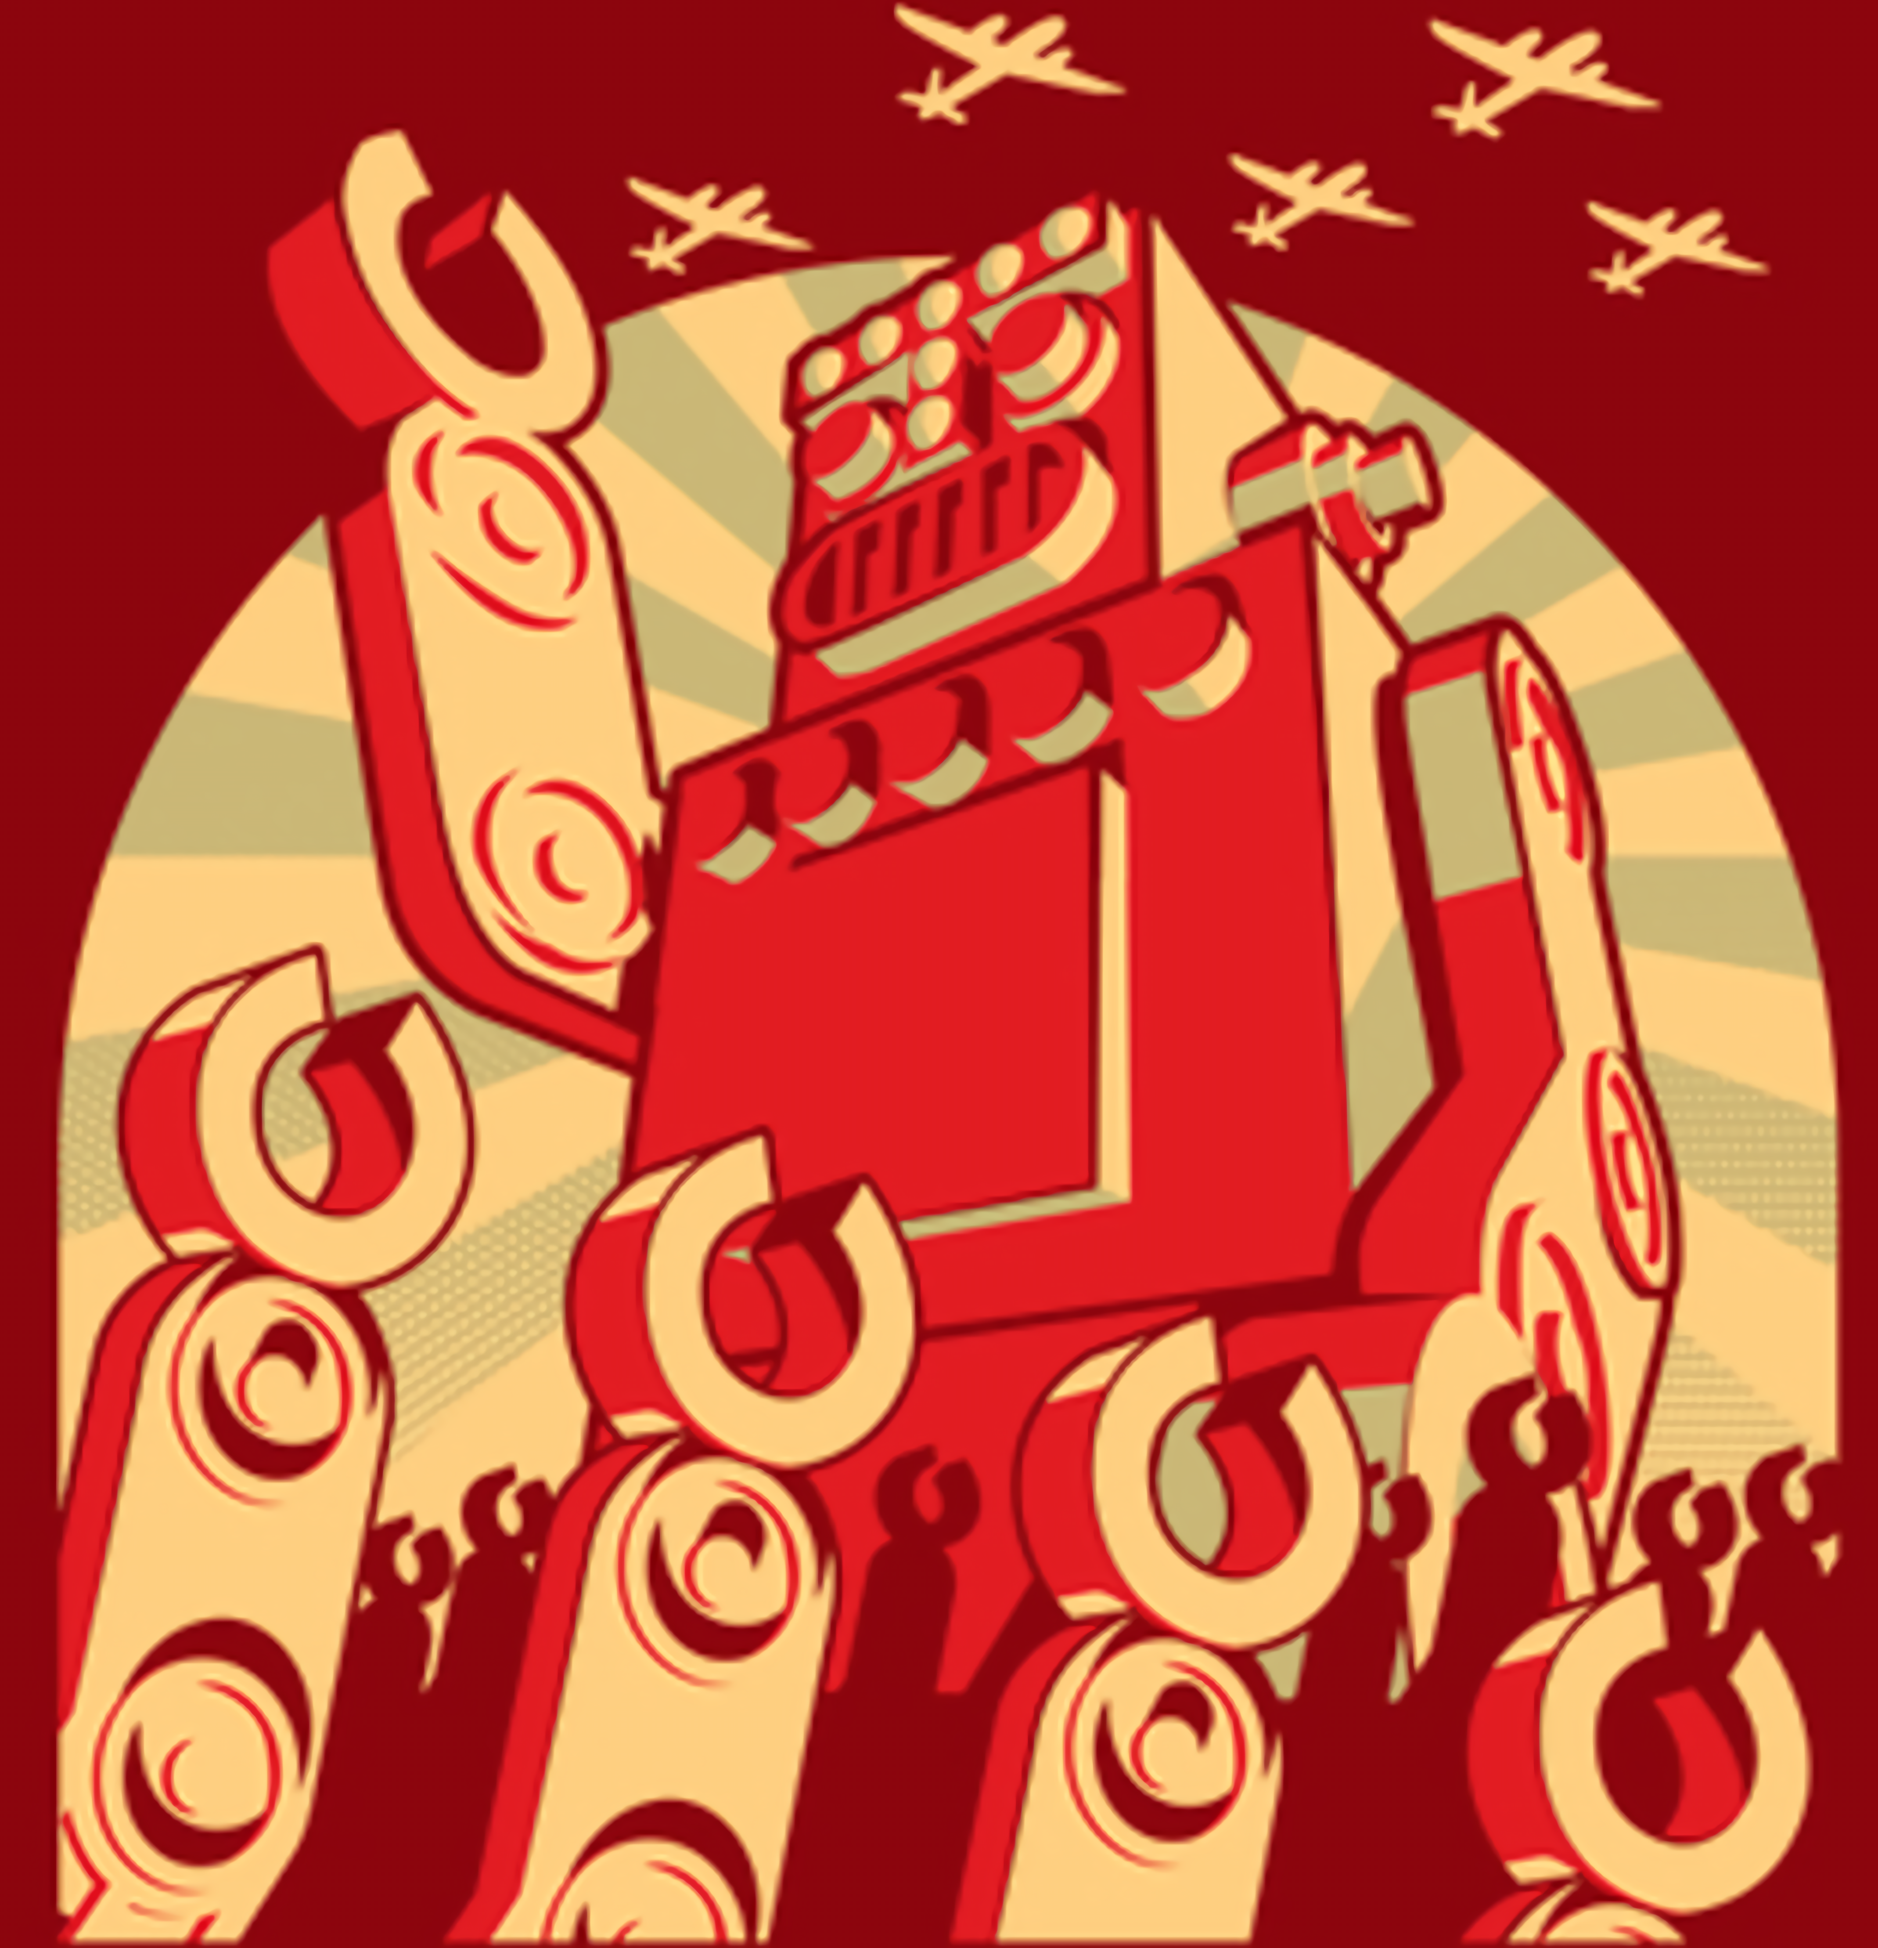
AI will take over the world
Notes:
Think of nuclear power
Our knowledge of AI comes from Hollywood movie

Slide 7
Extremely fast
Handles huge amounts of data
Much more accurate
Ideal for repetitive tasks
Reduces human errors
Initial capital investment
Might displace jobs
AI expertise is rare
Some applications better
done by humans
Artificial Intelligence
Notes:
Q Rachel: Alexiei, can you explain in simple terms what is AI and the value which it brings to an organisation?
Answer A1: What is AI?
Answer A3: What value or disadvatanges of AI?
Answer A2: Benefits / capabilities of AI?
AI is a multidisciplinary area of studies which seeks to create intelligent machines. The term AI is made up of two words, Artificial and Intelligence. Artificial simply means that it is something created by humans. Intelligence is a little more tricky to define since there isn’t a universal agreement on what it is. However, when we see intelligent behaviour, we tend to recognise it immediately. Because of this, we tend to define intelligence in terms of association. In fact, we consider a machine to be intelligent if it performs a function which only an intelligent organism (such as a human) or group of organisms (such as bees) can perform. So to summarise, AI is that field of study which create machines which exhibit intelligent behaviour.
The benefits of AI are various and its capabilities far reaching. It can be as simple as coordinating the climate control in a car, up to automatically managing a nuclear power plant. Because of this, AI is considered as a horizontal field of study which can easily transform practically any other area of study. The benefits of AI include the automation of various functions, the optimisation of different processes and the prediction of future events with an accuracy, which in most cases, is much better than any human can achieve.
AI can bring a lot of value added to any organisation. If the organisation is sitting on a pile of data, AI can easily process that data, analyse it, extract patterns and identify problems. In the case of manual processes, AI can help automate repetitive tasks which might be too tedious and in some cases, a health hazard for humans. An AI system is exact in its work, it does not get bored, suffers no fatigue, can foresee future trends and is capable of handling much more data than a person can ever manage. The disadvantage of such a system is first of all financial, because any AI requires an initial capital investment however, once it is up and running, it would need little to no maintenance. Second, the deployment of an AI system will most probably affect the people working in the organisations. Some of the them might lose their jobs. Others need to be re-skilled in order to learn how to perform different tasks with the assistance of an AI system.
Initial Capital Intvestment – promote re-engineering scheme

Slide 8
Everyday applications of AI
Email Spam Filter
Mobilephone assistant
Map Navigation
Document Correction
Automation (Robotic cleaners, Autopilot, etc.)
Fraud Prevention
(Shopping, Bank, etc.)
Recommender Systems (Shopping, Job Matching etc.)
Internet Search
Social Networking Sites
Notes:
Q Rachel: But is AI just the flavour of the moment? Is it just Hype?
Only 50% were aware that they had ever interacted with an AI device; however, when made aware of some common AI applications, over 95% indicated that they had used one of these services over the last year
Answer: A4: Practical applicaitons in everyday life?
As you correctly pointed out, AI is a very mature technology. Today, we can find it in almost any device we use. The only problem with AI is that a system which uses AI does not normally acknowledge this fact and as such, people are not aware of all the different AI systems they use in their day-to-day lives. Let me give you some examples. When one searches on Google, it is the AI that is actually sifting through millions of documents in order to locate the information you require. If someone goes on Facebook, it is the AI that is deciding the posts which are visible to the user. The climate control inside a car is managed by an AI system. The ovens which automatically adjust the cooking temperature according to what is being cooked are all managed by an AI system. Spam filters in your email client are powered by AI. The list can go on forever of course. What’s important to keep in mind is that AI is all around us and it is here to stay.

Slide 9
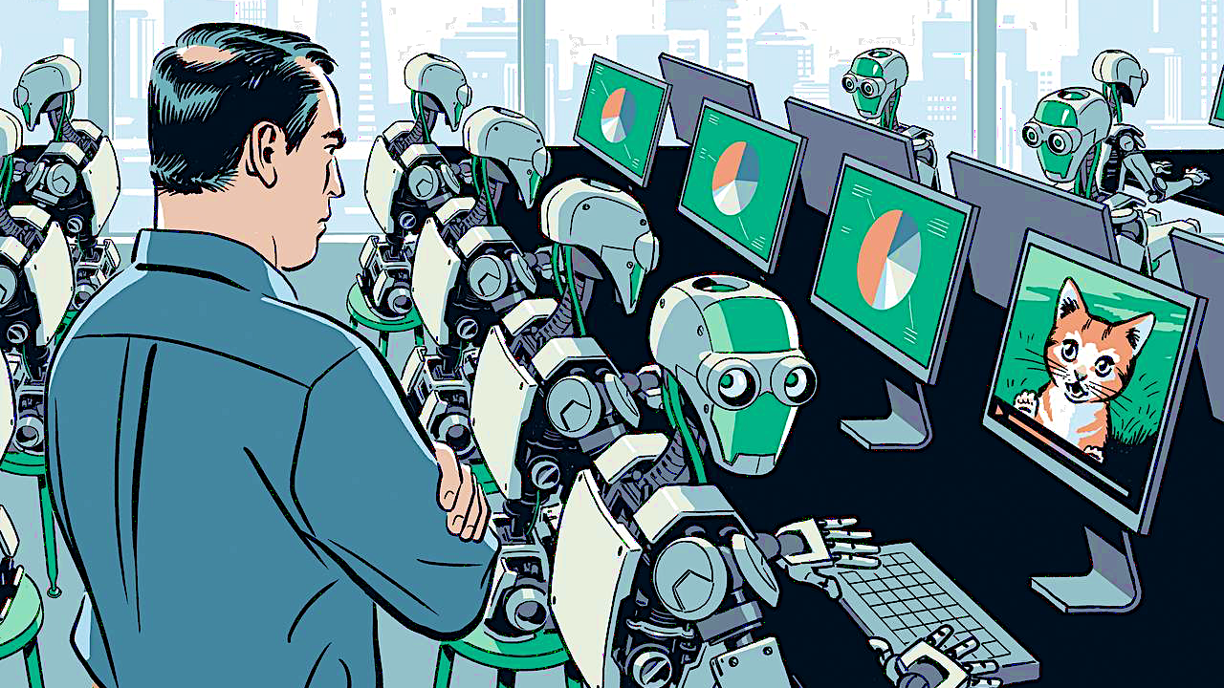
AI will take over our tasks

Slide 10
85 million
Jobs displaced by machines
97 million
New roles which will
emerge thanks to machines
Impact on Jobs?
* Source - World Economic Forum, The Future of Jobs Report 2020
Notes:
Q Alexiei: Of course, we’re talking of a very different world over here than the one we know. Rach, what is the impact on jobs?
R3: Impact on jobs?

Slide 11
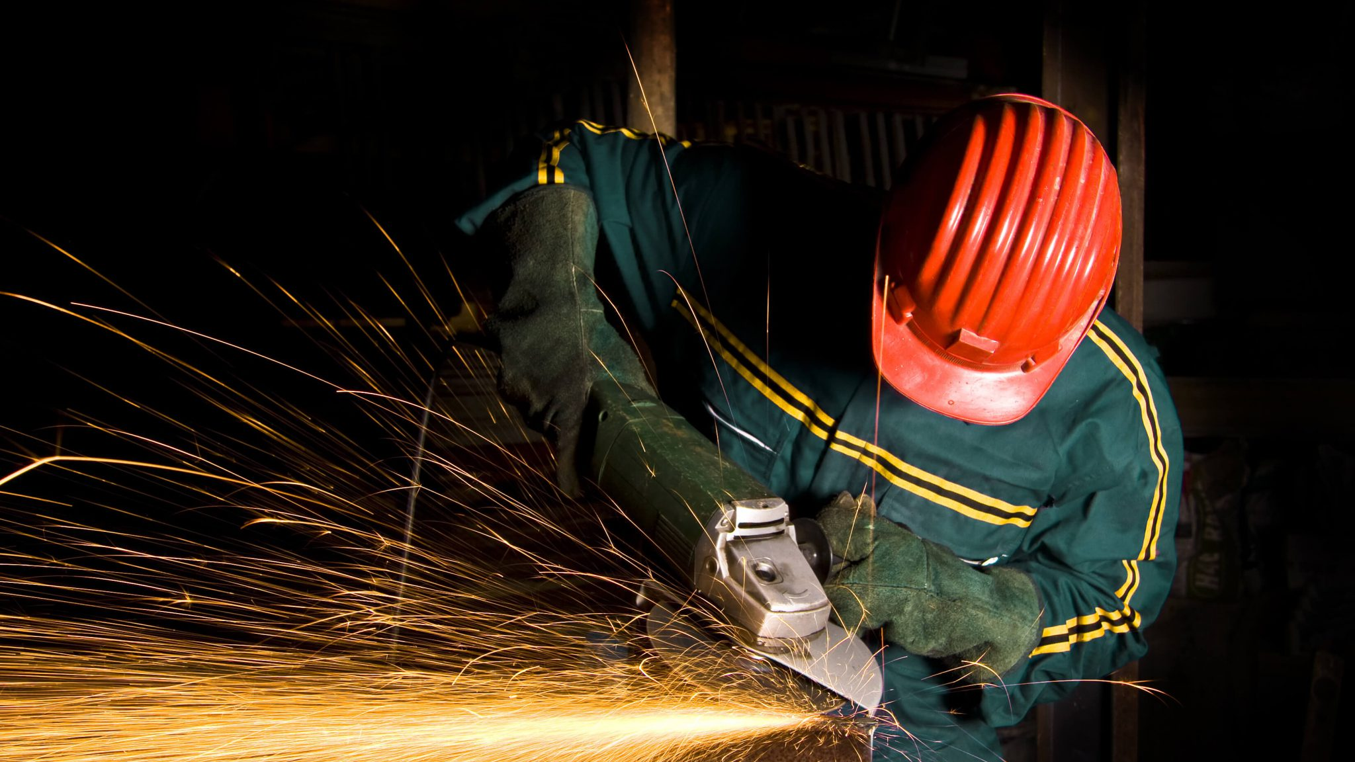
AI Will Replace Unskilled and Manual Workers
Notes:
Bulk is tasks
Lights out manufacturin

Slide 12
GRADUATION
BLACKHOLE

Slide 13
TRANSLATION
REPORT WRITING
SUMMARISATION
EMAIL DRAFTING
ANALYSING DATA
TRAINING
CUSTOMER CARE
TRAVEL PLANNING
SENTIMENT ANALYSIS
SOCIALMEDIA MONITORING
JUNIOR
2023

Slide 14
AI will not take over your job
(for now)
Someone who knows
how to use AI, will!

Slide 15
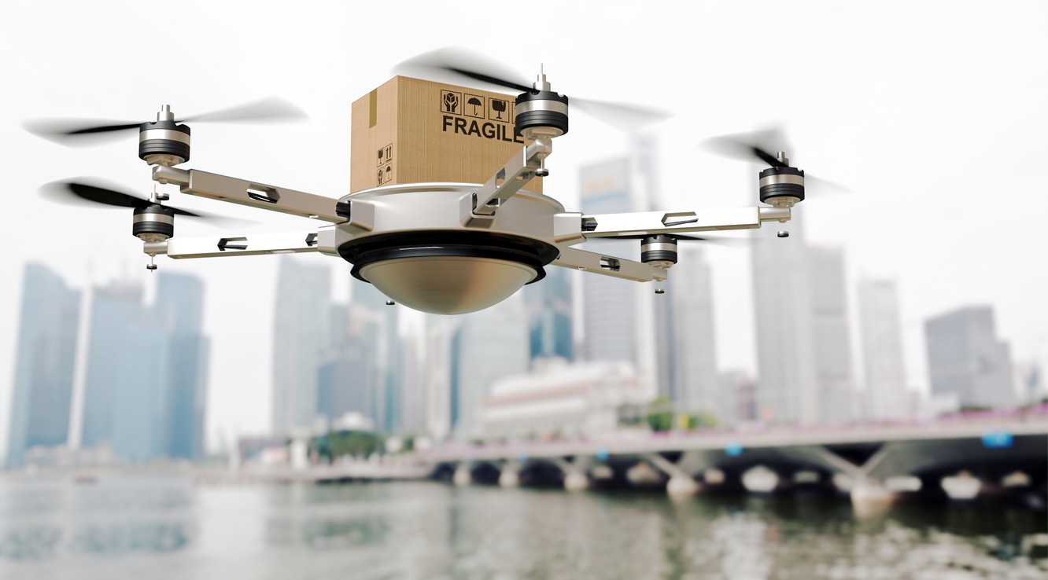
The end of the Platform Economy?

Slide 17
Data Analysts and Scientists
Al and Machine Learning Specialists
Big Data Specialists
Digital Marketing and Strategy Specialists
Process Automation Specialists
Business Development Professionals
Digital Transformation Specialists
Information Security Analysts
Software and Applications Developers
Internet of Things Specialists
Project Managers
Business Services and Administration Managers
Database and Network Professionals
Robotics Engineers
Strategic Advisors
Management and Organization Analysts
FinTech Engineers
Mechanics and Machinery Repairers
Organizational Development Specialists
Risk Management Specialists
Data Entry Clerks
Administrative and Executive Secretaries
Accounting, Bookkeeping and Payroll Clerks
Accountants and Auditors
Assembly and Factory Workers
Business Services and Administration Managers
Client Information and Customer Service Workers
General and Operations Managers
Mechanics and Machinery Repairers
Material-Recording and Stock-Keeping Clerks
Financial Analysts
Postal Service Clerks
Sales Rep., Wholesale and Manuf., Tech. and Sci.Products
Relationship Managers
Bank Tellers and Related Clerks
Door-To-Door Sales. News and Street Vendors
Electronics and Telecoms Installers and Repairers
Human Resources Specialists
Training and Development Specialists
Construction Laborers
Top 20 job roles in increasing and decreasing demand across industries
*Source Future of Jobs Survey 2020, World Economic Forum
Notes:
A9: How do you think AI will impact the future of work?
Work will probably be very different in the future.
Most of what we do will be augmented with AI.
It will be there in the background helping us to solve problems effectively.
Most probably, computers will become more ubiquitous.
The large desktops will disappear and processors will be integrated in everyday devices.
Whereas information is now restricted to a screen, in the future, it will roam through surfaces such as a table or a wall.
Tasks will migrate between services seamlessly thus making work pervasive as well.
The manipulation of data will become a piece of cake and everything will be connected together through Internet of Things (IOT) devices.
The future is an interconnected one, powered by AI but with people at the centre.

Slide 18
85
(million)
Unfilled jobs
The Skills Shortage 2030
$8.5 (trillion)
Unrealised
annual revenue
IMPACT
Team burnout
Decreased output quality
Increased cyber security risks
Delayed product launches
SOLUTION
Reskilling and upskilling (1 in 2)
Flexible hybrid teams
Work/life balance
Automation

Slide 19
Where do i start?

Slide 21
The AI Transformation Process
Project 1
Small
Quick-Win
Project 2
Medium
Quick-Win
Project 3
Large
AI
Training
AI
Readiness Audit
AI
Strategy
Few weeks
Weeks to Months
Months to Years
Capacity Building
Notes:
Q Rachel: When it comes to AI, how long would such a process take?
A7: How long will the AITP take?
The length really depends on the project. You have to keep in mind that there are many variables in such projects such as; what data is available, the quality of the data, the volume of data available, which algorithm to use, identifying the best approach to deploy such systems, what training is required, etc. An initial project will probably take between six months and three years. Then the cycle is repeated.

Slide 22
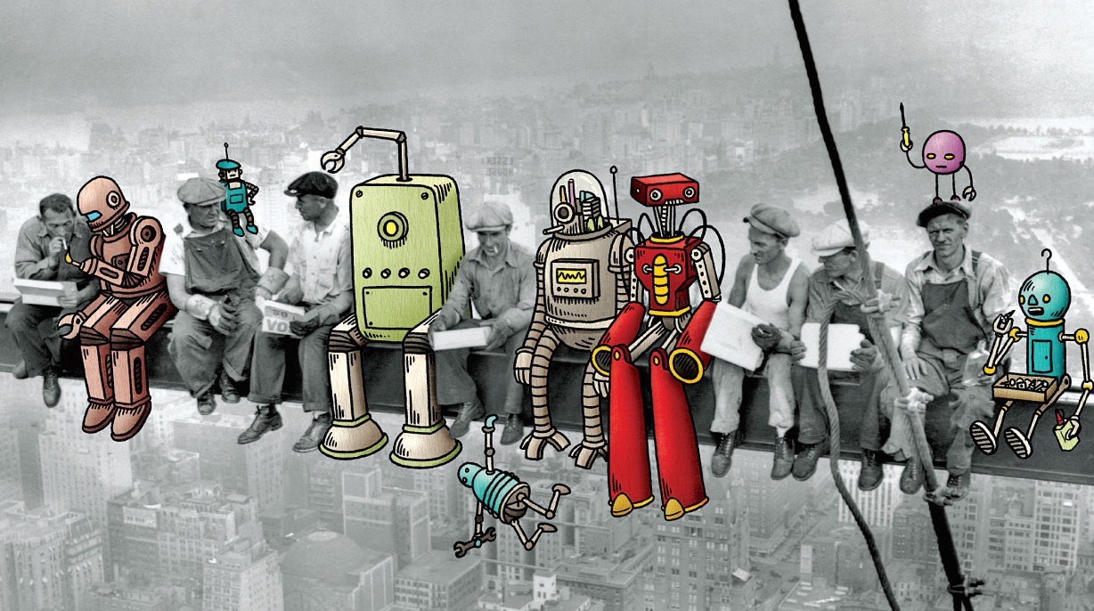
THANK YOU
Prof. Alexiei Dingli
alexiei.dingli@um.edu.mt

